Slide 1


Status of the UK Superconducting Undulator Studies
Jim Clarke
ASTeC, STFC Daresbury Laboratory
FLS 2012, March 2012

Slide 2
Setting the Scene
RAL has a long and distinguished history in the field of SC magnets and more recently with closed loop cryogenic systems
  SC magnets particularly for particle physics applications
  Cryocoolers primarily for space applications
Daresbury has a similar position in the field of light sources and undulators
Since 2004 the two groups have worked together on SCUs
Recently Diamond has also joined the team

Slide 3
Helical SCU Motivation
The International Linear Collider requires unprecedented numbers of positrons when compared with present day sources
If the positrons can be polarised then the physics reach of the collider can be enhanced
ILC Baseline – Synchrotron radiation from an undulator
  Very high energy electrons
  Short period undulator
  Lots of Periods for high intensity
  Helical undulator ➔ circularly polarised photons
The UK team was established to confirm the feasibility of the helical undulator and to build a full scale prototype

Slide 4
Undulator Parameters
Undulator to be made of 4m long modules

Slide 5
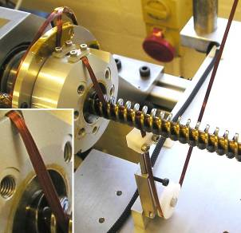
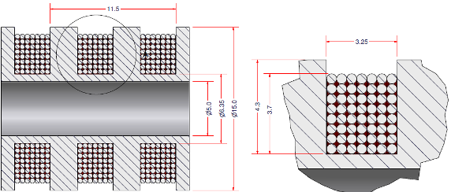
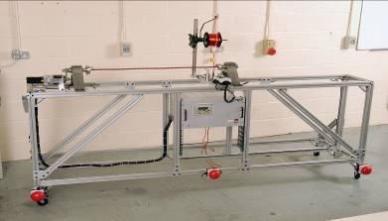
NbTi Winding
Wound with 7 wire ribbon, 8 layers
Ø0.4 mm NbTi wire, with 25 µm enamel (Ø0.45 mm when insulated)
3.25 mm wide winding for 11.5mm period
Packing factor of 62%
5

Slide 6
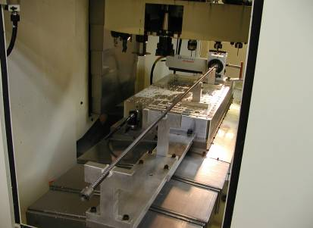
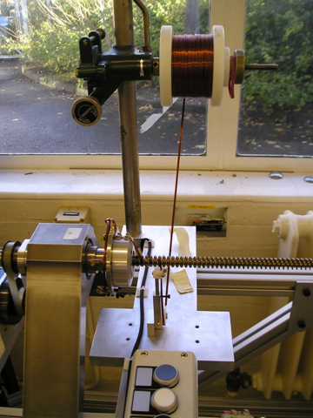
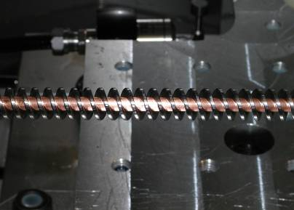
4m Prototype manufacture
4 axis machining
Coil winding
Iron former fixed on Cu bore tube
Notes:
Here you can see some key points in the manufacture
The 1st is a picture of the iron former being machined the next
The 1st step in the sequence is to have a 2m iron rod is gun drilled this creates a very straight hole the rod is then turned concentric with the axis of the gun drilled hole.
Then is a sacrificial tube filled with silver solder put into the bore to allow the helix it to be machined.
Following machining the iron helix is placed on the copper bore tube. Nd aligned , the ends of the former are soldered to the copper bore tube and then the superconducting ribbon is wound on

Slide 7
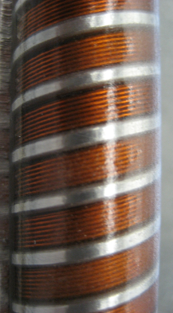
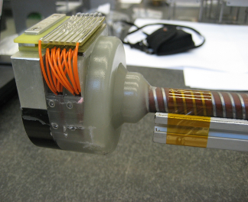
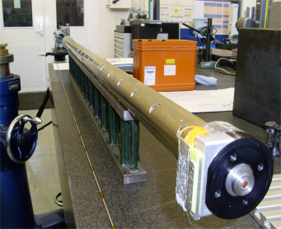
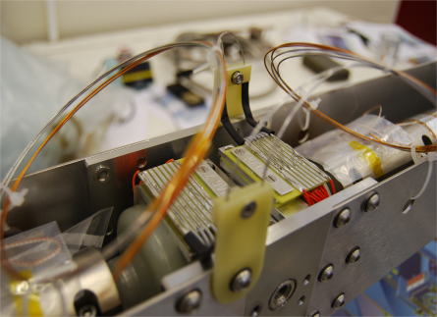
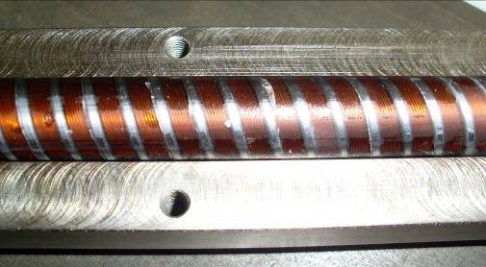
4m Helical SCU Prototype
Period = 11.5mm
B = 0.86 T

Slide 8
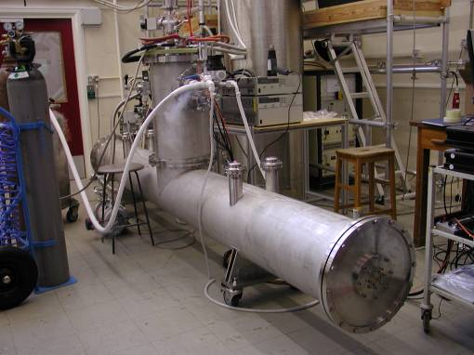
Cryomodule
A 4m module containing 2 x 1.75m helical undulators (11.5 mm period) has been constructed
Closed loop cryo system with cryocooler (4.2K LHe bath)

Slide 9

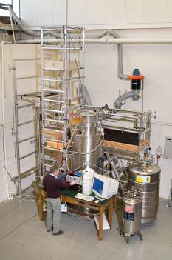
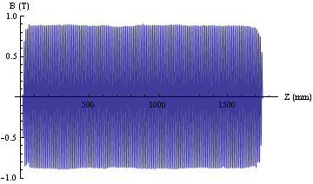
Vertical Tests
The quench test results show different behaviour between the two identical magnets
Both do actually reach the same final quench current which agreed well with expectations
300A = 1.15T (spec is 0.86T, 215A)
D J Scott et al, Phys Rev Lett, 107, 174803 (2011)

Slide 10
Planar SCU for Light Sources
Successful helical undulator project helped secure funding for planar studies
Same team of people
Diamond has also joined the project
It is planned that the first planar SCU will be installed into Diamond (3 GeV)
  Beamlines requiring up to 40 keV

Slide 11
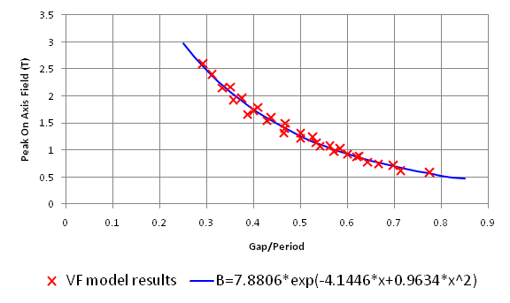
B Field Parameterisation
A series of models have been run with Opera 3D as a function of gap and period, with realistic winding layouts
A fit to the model results (see plot) gives a useful parameterisation for comparison against other technologies
Equation valid for 0.25 < g/λ < 0.8
V Bayliss, RAL

Slide 12
Selection of Parameters for Diamond
Detailed modelling of the flux and brightness output carried out by Diamond with SCU empirical field equation
Minimum vertical beam aperture set to be equivalent (scaled for length) to current smallest fixed aperture vessel (8mm over 5m)
Period and total length selected to cover tuning range from 6.5 keV upwards and optimised at 25 keV and 40 keV.

Slide 13
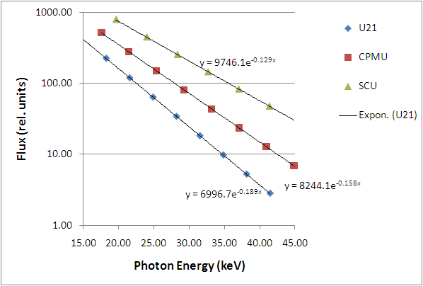
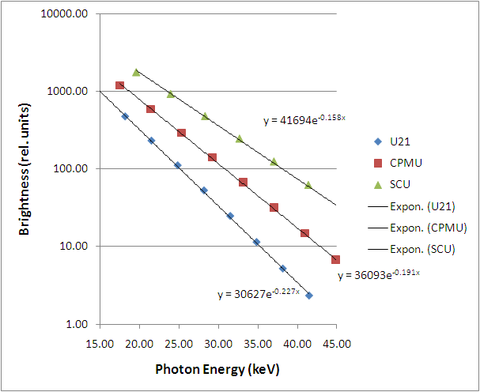
Selected Parameters
SCU:
period = 15 mm
N = 133 (2m long)
BSC = 5.4 mm
pole gap = 7.4 mm
B_{o} = 1.28 T
K = 1.8
SCU/U21
 | Flux | Brightness
25 keV | 6.2 | 7.6
40 keV | 15.4 | 21.5
R Walker, Diamond

Slide 14
Design Features
Cold bore magnet with 5.4 mm aperture vacuum vessel at ~12 K
Magnet gap 7.4 mm to allow vacuum gap between vessel and magnet poles
Magnet to operate at ~1.8 K in order to reach desired field level on axis
Closed cycle pumped cryo system used to achieve 1.8 K

Slide 15
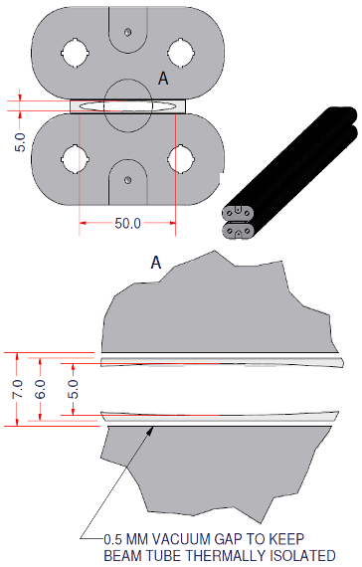
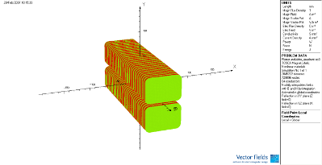
Technical Specifications
  Peak field in winding ≈ 3.5 T
  Operating current ≈ 450 A
  Operating margin at 1.8 K ≈ 10%
  Av. Current density ≈ 1800 A/mm²
  Magnet Gap = 7.4 mm
  Rectangular NbTi wire = 0.66 x 0.37 mm
  Winding: 6 wide by 11 deep
  No in-built local correction system
7.4 6.4 5.4

Slide 16
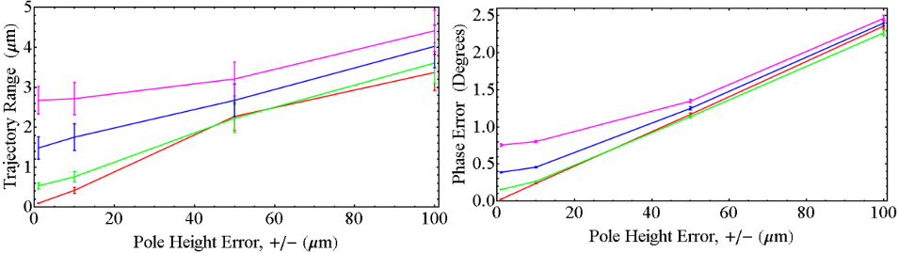
Tolerances
Radia Modelling
Effect of pole height error for a pole length error of ±1μm (red), ±10 μm (green), ±50 μm (blue) and ±100 μm (magenta)
Error bars define 99% confidence levels
Errors assume top hat distribution
D J Scott, Daresbury

Slide 17
SC Wire
NbTi procured from Supercon
Cu:SC of 0.85:1.0
0.5mm diameter round wire has been rolled to rectangular to improve packing factor

Slide 18
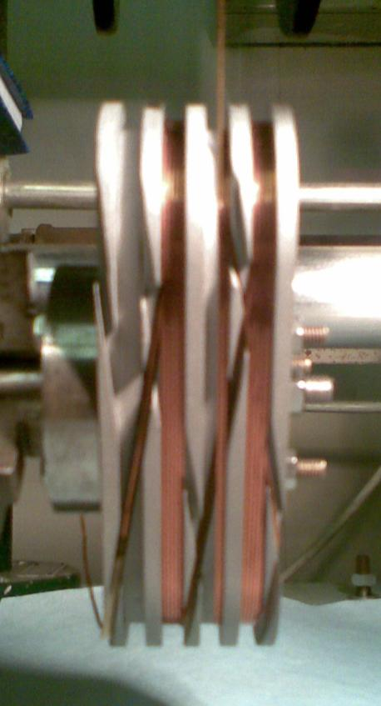
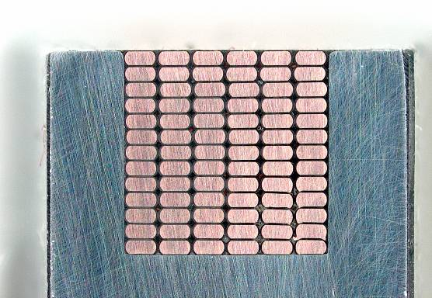
Winding and Former Trials
Initial winding trials have been done with a four coil former and rectangular section (0.635mm x 0.305mm) insulated Cu wire.
Objective was to devise a winding/potting procedure which would position/align the wires to within 10 microns in y.

Slide 19
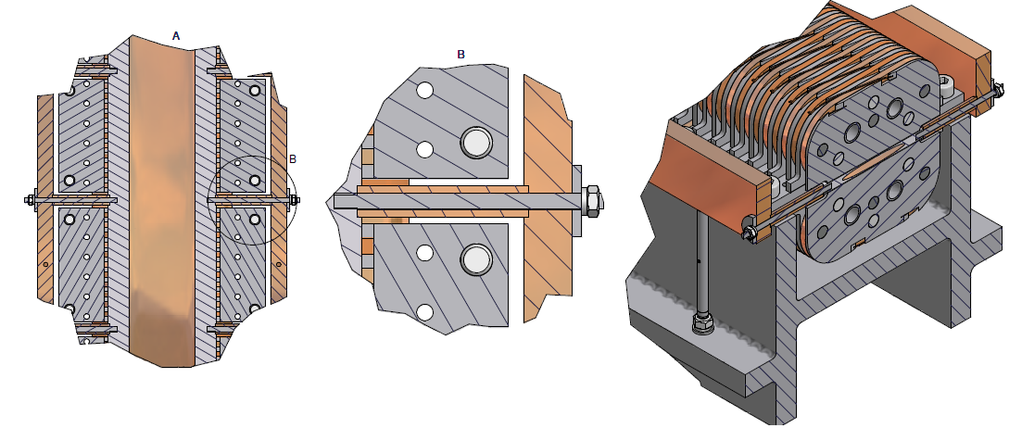
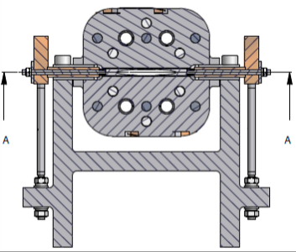
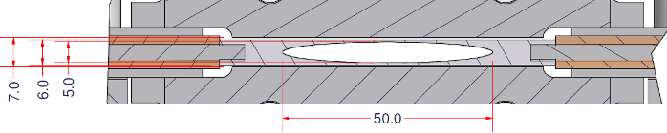
Undulator Assembly
Beam Tube Cooling / Support Bar (12 K)
Beam Tube Cooling Bus Bar (12 K)
Helium cooling tube (1.8 K)
Beam Tube (12 K)
Magnet Former (1.8 K)
Magnet Separation Block (1.8 K)
2 mm Vacuum Gap
Magnet Support Beam (1.8 K)
Beam Tube (12 K)
Magnet (1.8 K)
0.5 mm Vacuum Gap
Notes:
19

Slide 20
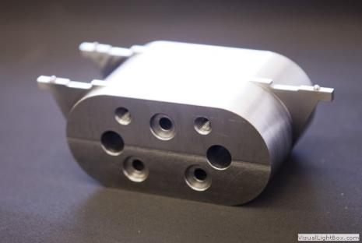
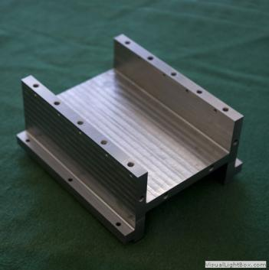
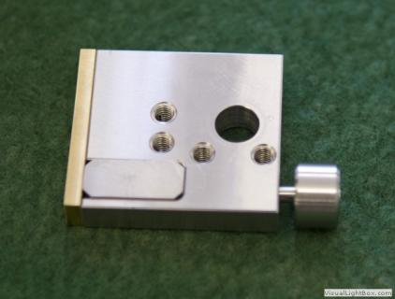
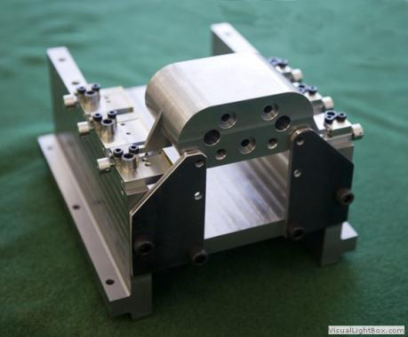
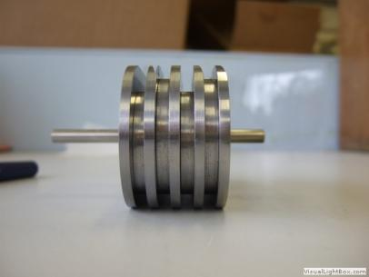
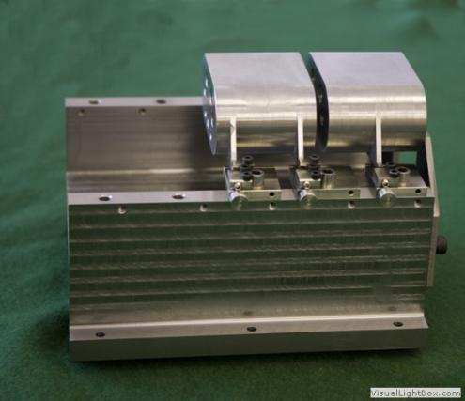
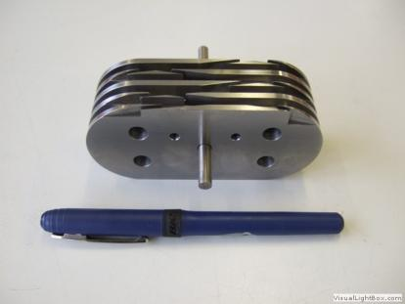
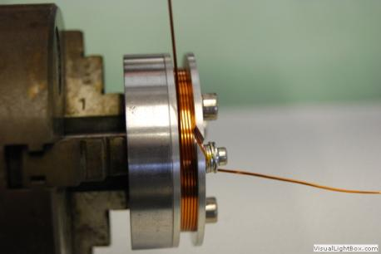
Short Former Alignment Tests

Slide 21
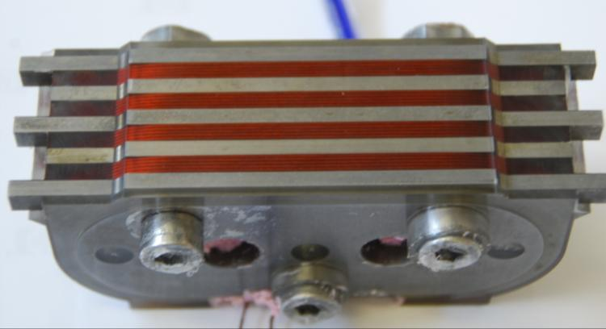
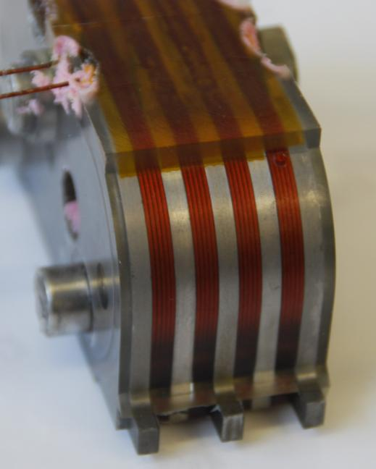
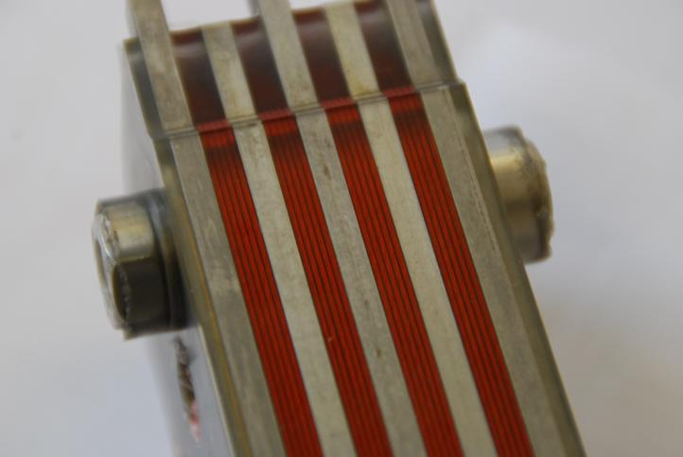
Short Former Winding Tests

Slide 22
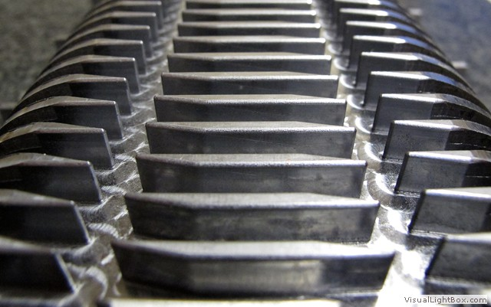
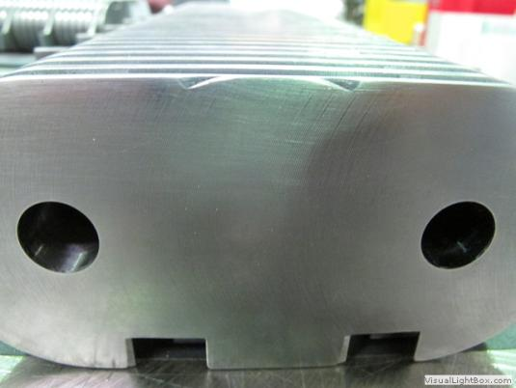
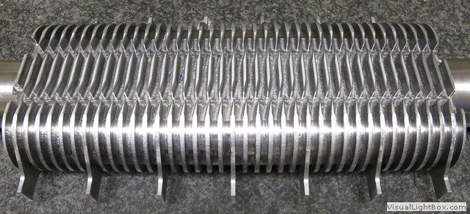
First 300 mm Former

Slide 23
SC Planar Future Steps
Assemble the turret test rig and confirm the cooling powers expected are achieved
Construct a short 300 mm magnet array to confirm tolerances are achieved – vertically test
Construct full length magnet (2m active length)
Assemble and test complete undulator
Install into Diamond in 2014 (replace existing in-vac undulator), confirm cryo and magnetic performance

Slide 24
FEL Case Study
Comparison of our SCU vs in-vacuum PPM (with Br = 1.3T)
Gap refers to vacuum aperture
a_{w} = K_{rms}
N Thompson, ASTeC

Slide 25
FEL Case Study
Tuning Required from 1Å to 4Å
  Assume at 1Å the minimum undulator parameter is a_{w} = 0.7 (K~1)
  Assume 4Å at minimum gap
Two different minimum gaps considered: 6mm and 4mm.
For each of the 4 cases have determined
  required undulator period and beam energy to give required tuning with given constraints
  Undulator parameter a_{w}, FEL saturation power P_{sat} and SASE saturation length L_{sat}, all as a function of FEL wavelength, using the Ming Xie formulae
Electron Beam Properties
  I_{peak} = 3400A
  Normalised emittance ε_{n} = 0.5 mm-mrad
  rms energy spread σ_{E}/E = 10⁻⁴
  β-function: the value between 3-50m that minimises the gain length
N Thompson, ASTeC

Slide 26
FEL Case Study
 | Period (mm) | Beam Aperture (mm) | Tuning Range (nm) | Energy (GeV) | Saturation Length (m)
XFEL SASE2 | 47.9 | 7.6 | 0.1 to 0.4 | 17.5 | 174
PPM | 28.9 | 6.0 | 0.1 to 0.4 | 7.5 | 82
PPM | 24.9 | 4.0 | 0.1 to 0.4 | 7.0 | 71
SCU | 19.7 | 6.0 | 0.1 to 0.4 | 6.2 | 60
SCU | 16.7 | 4.0 | 0.1 to 0.4 | 5.7 | 52
N Thompson, ASTeC

Slide 27
P_{sat} and L_{sat} vs Wavelength
N Thompson, ASTeC

Slide 28
FEL Case Study Conclusion
For the given 1-4Å tuning range and constraint on minimum acceptable undulator parameter, by changing from the permanent magnet undulator to the superconducting undulator:
  the required electron beam energy is reduced by 17.5%
  the FEL saturation length is reduced by 30% across the tuning range
  BUT the saturation power is reduced by ~20% across the tuning range (mostly due to lower beam power)
  This applies for 6mm and 4mm minimum gap
N Thompson, ASTeC

Slide 29
Summary
SCU Helical constructed from NbTi and full spec achieved (0.86T @ 11.5mm)
SCU Planar design virtually complete (NbTi) and parameters selected for Diamond
  1.28T @ 15mm, 1.8K magnet with 5.4mm vacuum aperture
Winding trials underway
Turret system procured and will be assembled and performance confirmed this year
Scheduled installation of SCU into Diamond early 2014
Clear advantage of SCU for 3rd and 4th generation light sources if specifications can be achieved

Slide 30
Thanks to the team!
ASTeC, Daresbury – Duncan Scott, Ben Shepherd
Technology Department, RAL – Vicky Bayliss, Tom Bradshaw, Amanda Brummitt, Geoff Burton,Simon Canfer, Mike Courthold, George Ellwood, Mike Woodward
Diamond Light Source – Emily Longhi, Jos Schouten, Richard Walker

